Slide 1

RAMP Grant Application Training
2026 RAMP Grant Year

Slide 2
RAMP Board 15 COMMUNITY VOLUNTEER MEMBERS
Arts & Museums
(7 members)
Advisory Board
(7 members)
Recreation & Parks
(7 members)
Kevin Burns, Chair
Ernie Gonzalez
Korry Green
Bret Holmes
Jim Craig
Dana Gibson
Liz Morrison
Jim Craig, Chair
Ernie Gonzalez
Dana Gibson
Sylvia Newman
Jordan Brun
Oscar Mata
Mary Jo Boylan
Korry Green, Chair
Liz Morrison
Bret Holmes
Zachary Thomas
Alexis Jackson
Chris Zimmerman

Slide 3
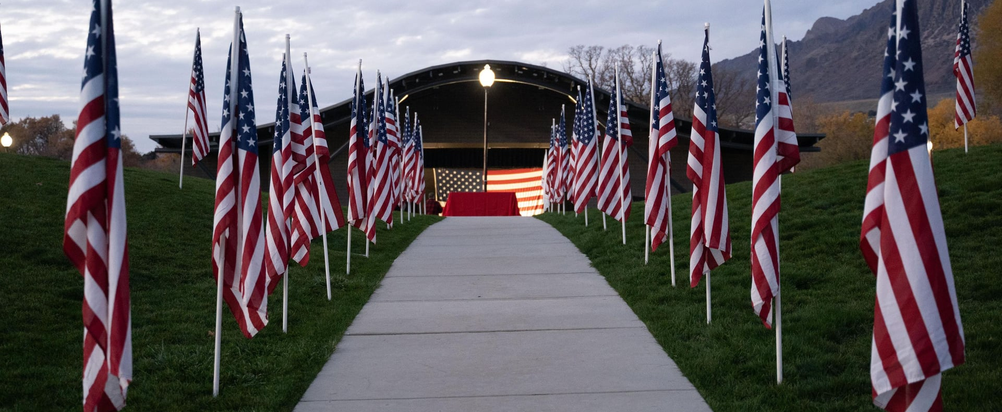
Your Quality of Life
In 2004 and again in 2014, you authorized Weber County RAMP to fund enhancements for Recreation, Arts, Museums and Parks in your community.

Slide 4
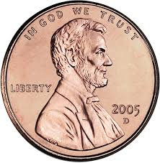
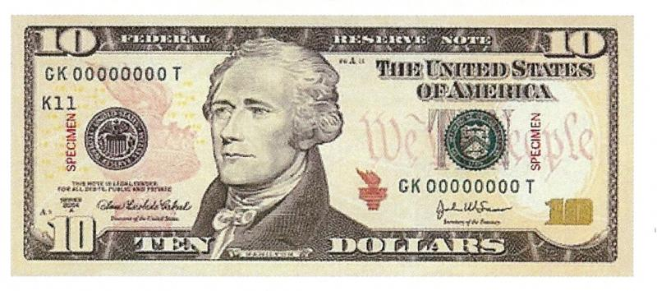
Your Investment
=
RAMP is funded by a sales tax of 1/10 of 1% or one penny for every $10.
The average Weber County family invests $12 per year in RAMP.
That $12 dollars generates more than $5 million per year for community projects.

Slide 5
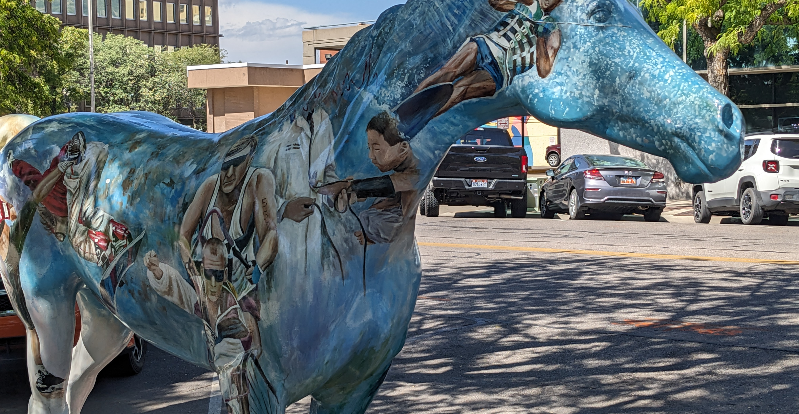
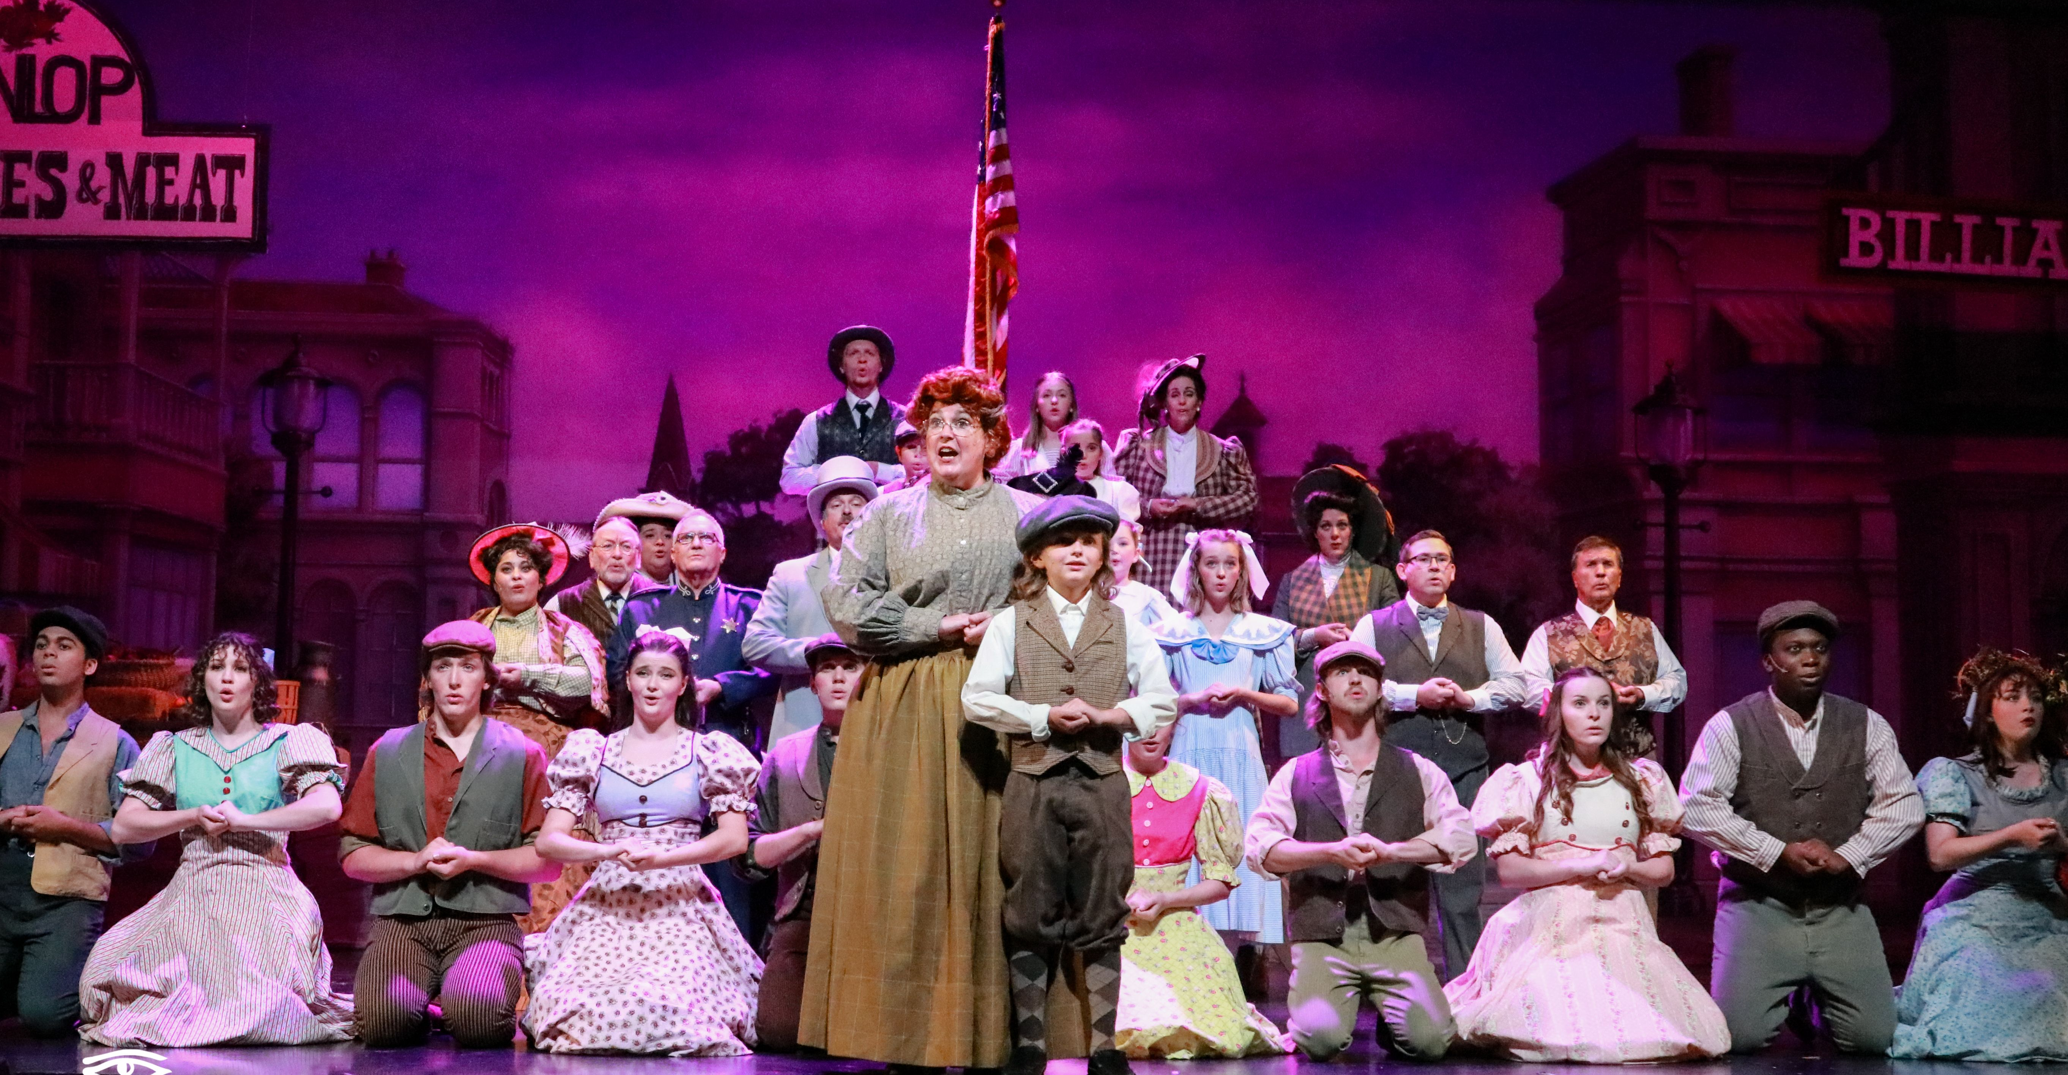
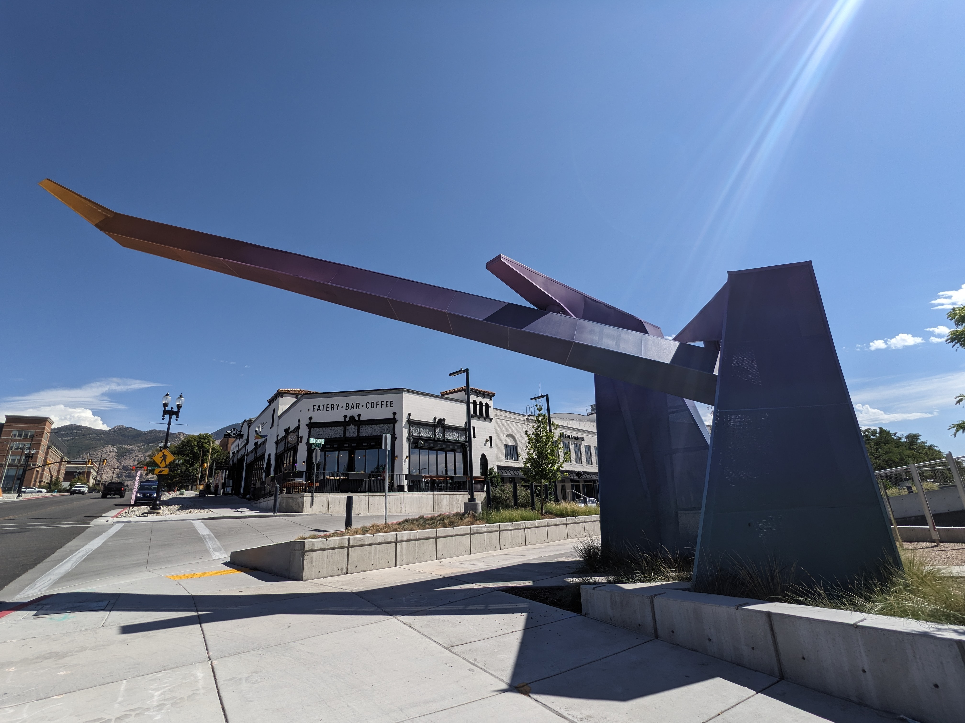
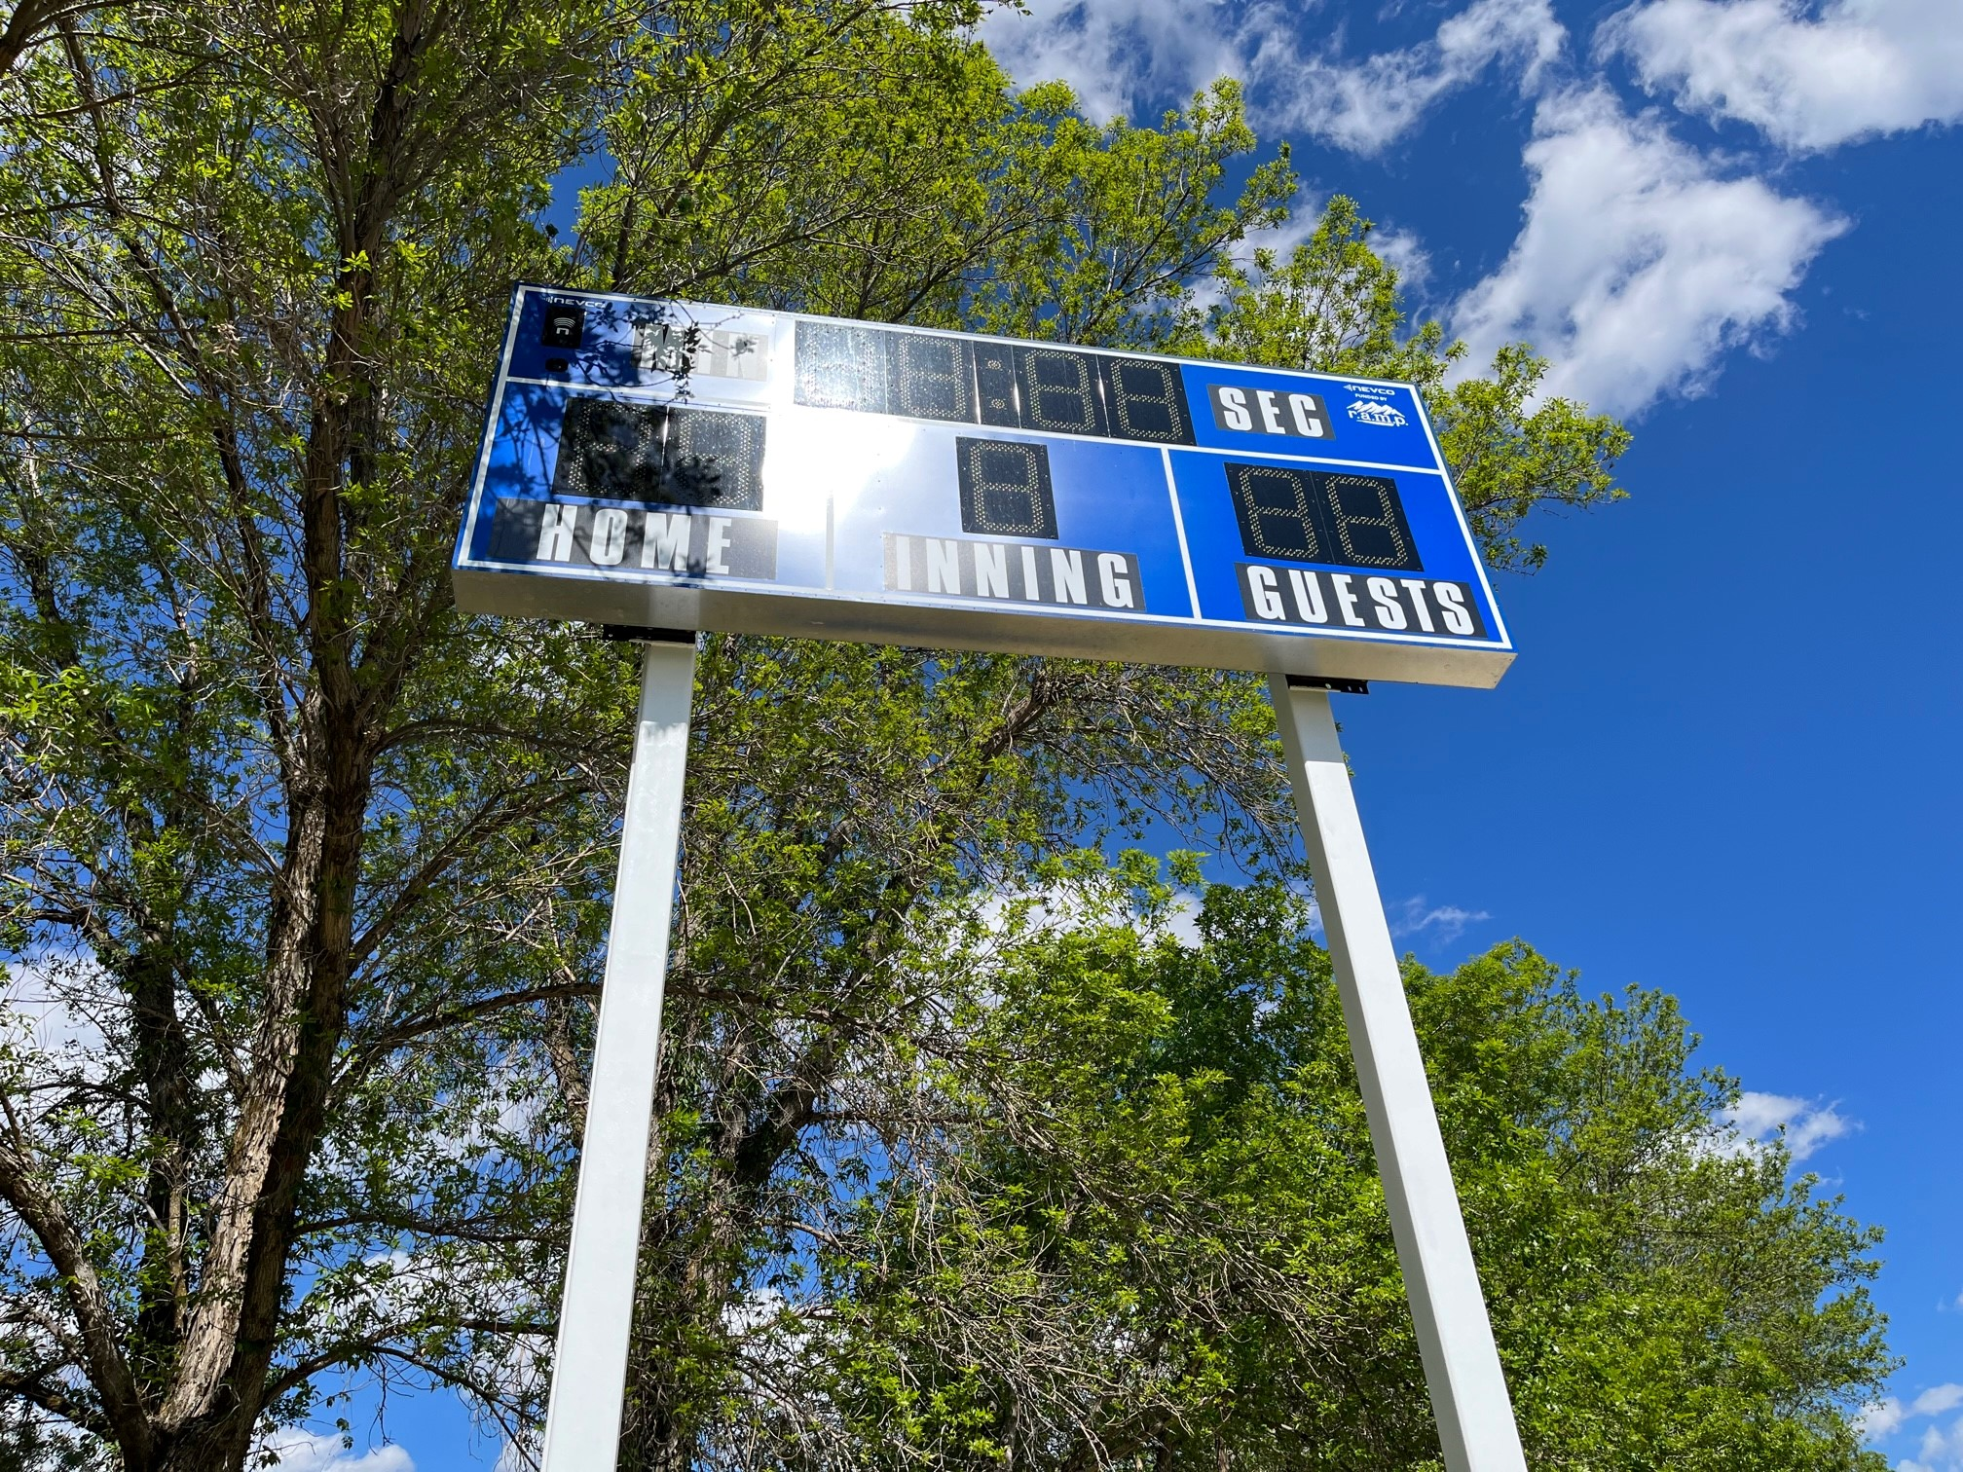
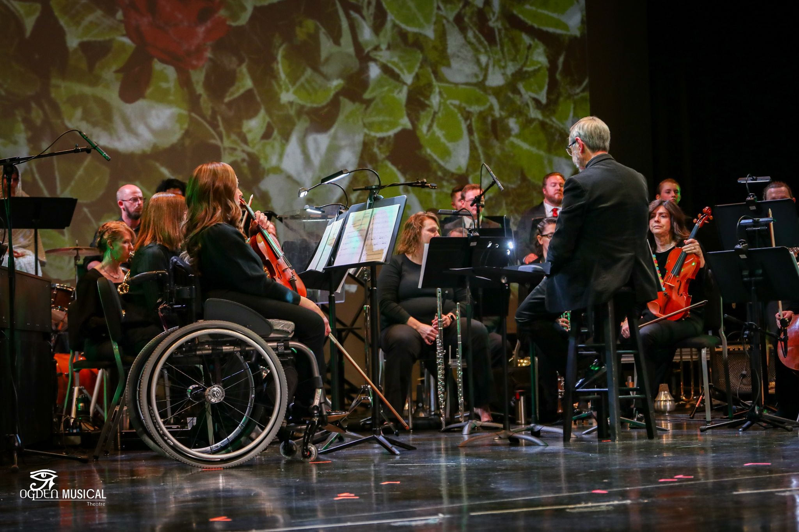
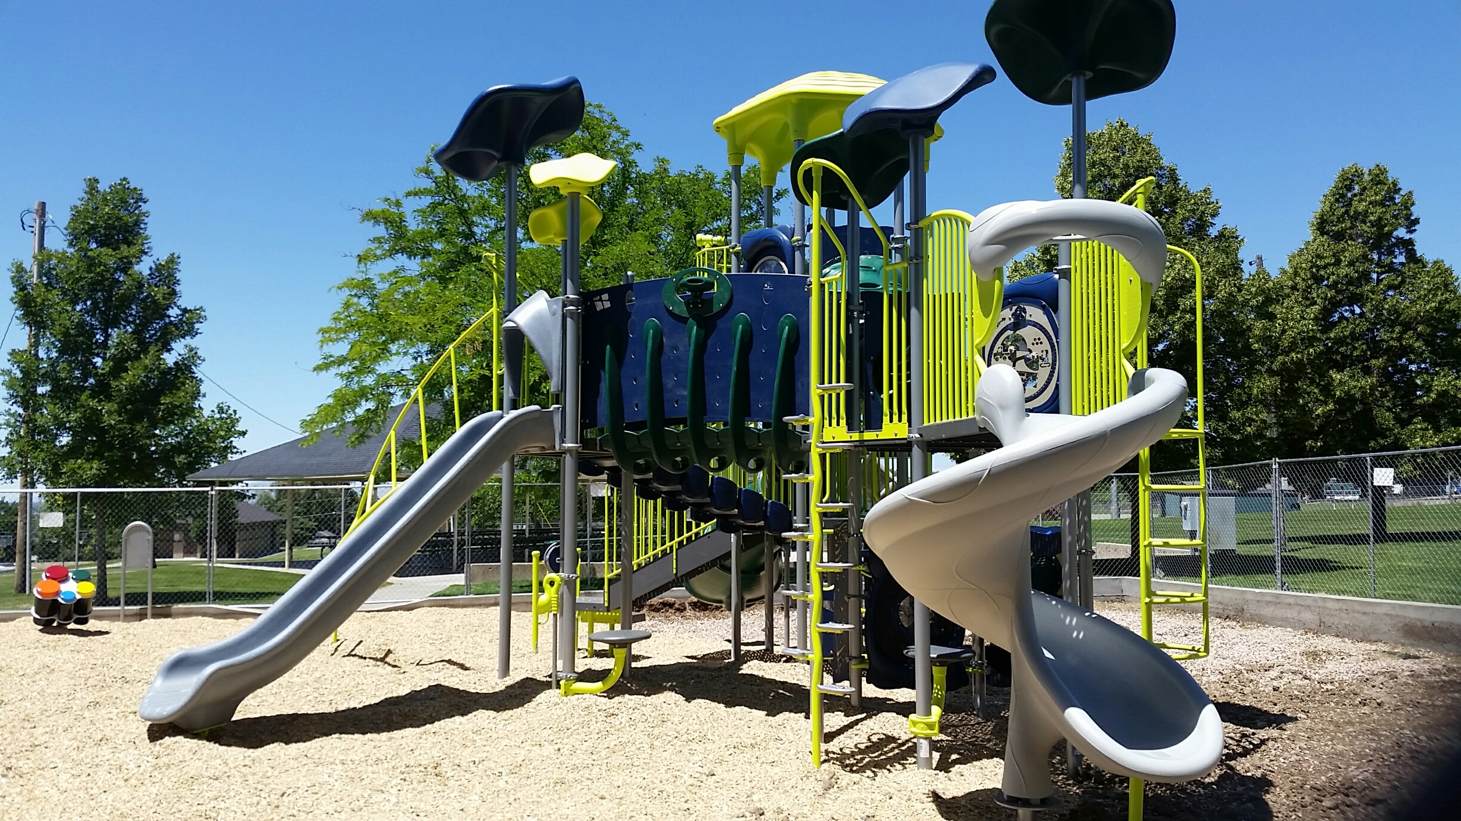
RAMP in Weber County Over $66,738,926 in grants have been invested in our community through RAMP. Over 120 non-profit organizations and municipalities have been able to create amazing projects and programs because of RAMP.

Slide 6
2025 RAMP Funding
$7,068,000
Major Grants (1/3)
Arts & Museums – Parks & Rec (2/3)
1/3 = $2,356,000 Major Funds
2/3 = $4,712,000
- $273,073 Municipal Grants
$4,438,927
- $80,000 Free Summer Saturdays
$4,358,927 Divided by 2
Arts & Museums
½ = $2,179,463
Parks & Rec
½ = $2,179,463
$ in Requests
$ in Requests
$ in Requests

Slide 7
2025 RAMP Funding
$7,068,000
Major Grants (1/3)
Arts & Museums – Parks & Rec (2/3)
1/3 = $2,356,000 Major Funds
2/3 = $4,712,000
- $273,073 Municipal Grants
$4,438,927
- $80,000 Free Summer Saturdays
$4,358,927 Divided by 2
Arts & Museums
½ = $2,179,463
Parks & Rec
½ = $2,179,463
$5,126,553.00 in Requests
$3,250,117.40 in Requests
$1,521,071.24 in Requests Remaining $658,391.80

Slide 8
Eligibility
In order to qualify for funding:
An applicant must be a Weber County city or a non-profit organization operating within Weber County. The project must be held in Weber County.
The non-profit organization must be a “resident” of Weber County and have met all eligibility requirements for the preceding three years.
If it is an organization or program affiliated with a university, college, or educational institution:
The project must serve predominantly the community as opposed to students and faculty.
The institution must receive less than fifty percent of its support from government funding.

Slide 9
Recreational Facility For Recreational and Parks purposes, RAMP Tax may be used to fund recreational facilities. RAMP Ordinance 24-7-1; 24-7-3; 24-7-4
Recreational Facility
Campground
Dock
Marina
Golf course
Playground
Athletic field
Gymnasium
Swimming pool
Trail system
Park
Other facility used for recreational purposes
Publicly Owned
Or
Operated

Slide 10
Cultural Facility For Arts and Museums purposes, RAMP Tax may be use to fund Cultural Organizations or Cultural Facilities. RAMP Ordinance 24-7-1; 24-7-3; 24-7-7
Cultural Facility
Publicly Owned
Or
Operated
Theater
Museum
Art center
Music hall
Other cultural or arts facility

Slide 11
Cultural Organization
Primary purpose is the advancement
Organization
and preservation
of -
Natural History
Private non-profit
Institution
History
Art
Administrative Unit
Music
Theater
Dance
An administrative unit is division of a non-profit organization or institution that-
a. would, if it were a separate entity be a cultural organization.
and
b. consistently maintain books and records separate from those of its
parent organization (UCA-5912-702(1)
Literature
-
-
Motion pictures
Story telling
Primary purpose is the advancement
and preservation of -
History
Natural history
Art
Music
Theater
Dance
Municipal or County
Cultural Council

Slide 12
Criteria for Funding
The burden is on the applicant to demonstrate that it meets all eligibility requirements.
All funded facilities must be physically located in Weber County. (When possible, it is also recommended that funds be spent with vendors in Weber County).
Preference will be given to collaborative projects and projects that are funded in part by the applying entities.
On the basis of the grant, the applying entities are required to raise additional monies specifically for the funded project. Application must show matching funds as guaranteed.
Applying entities must provide for perpetual maintenance and operating funding for all facilities for which funding is requested.
All funded projects must be made available for use to all Weber County residents.
Reasonable non-discriminatory user fees may be charged for the use of the facilities.
The total amount of grant money must be spent on the funded project and must be used within Weber County.
NOTE- If you are planning a “Recreation Festival” check the Arts & Museums Box and make sure your mission statement matches.

Slide 13
What RAMP Won’t Fund-
RAMP does not fund contingency fees, insurance, architecture, studies, employee salaries, prizes, trophies, refreshments, fireworks, drone shows, food items, city marquee/message boards, or fundraisers.
Stipends are only paid for special guest performers, teachers or musicians. Employees or regular performers cannot be paid with RAMP funds.
Project planning, design, architecture, etc. can be used as a match but cannot be a paid expense of a RAMP grant.
Any RAMP money awarded and not used as outlined in your budget must be returned to the county.
Costs such as police, fire department, trash pick-up, city workers, etc., should only be included if they are a real expense for the project that funding is being requested for.
RAMP will not be the first funding on a project.
RAMP funds cannot be re-granted.
RAMP is never guaranteed.

Slide 14

VOLUNTEER MATCH
A volunteer is someone who freely offers to participate in an activity or perform a service without expecting payment.
These hours will be calculated at $20.00 per hour as an applicant’s match.
A professional service is a service that requires specialized knowledge and skills, often of a mental or intellectual nature.
These types of services typically require a license, certification, or registration.
Examples include but are not limited to lawyers, doctors, accountants or engineers, architects.
These matches can be calculated at actual cost of the specific service and verified as part of the reporting process.

Slide 15

Budget Reminders
The budget form on the RAMP website is now required.
Any costs for which RAMP funds will be used must have competitive bids/estimates and/or cost comparisons.
Matching funds must be guaranteed.
Budgets must include a list of all project expenses with a separate list of RAMP expenses.
Always include other funding sources for the project as well as any in-kind donations or volunteer work that will be used.

Slide 16
Include on Your RAMP Grant Application
Amount applying for- Whole numbers only, no change
Type of Grant (Check correct square on top right of application).
1 – Major: Requests for $200,000 or greater.
2 – Regular: Requests for $2,001.00 to $199,999.
3 – EZ: Requests for $2,000 or less.
Grant Category & Classification
1 – Parks & Recreation
Your classification must be for a Recreational Facility
2 – Arts & Museums
Your classification will be for either a Cultural Facility or Cultural Organization
Mission Statement
The mission statement of your organization should be approved by your board members or council and be in line with the
statutes and ordinances that govern the RAMP tax. (Be sure your mission statement complies with RAMP- Recreation, Arts,
Museums, Parks that improve quality of life for Weber County residents). If you change your mission statement to align with
RAMP, please get your boards approval.
It must be permanent, not just for RAMP applications.
Project Name
Provide a short title that will identify what your project is for. Do not use the same name for more than one year, if it is a multi-
phase project, include the phase number in the project name.
EZ Grant Applications
EZ grant applications must include a summary and a budget.

Slide 17
Completion Reports are due June 30th of the following year.
Points will be deducted for late reports, no reports or failed audits.
Points will be awarded for non tax-dollar collaboration.
Each entity can only turn in a total of:
(1) Major Grant Application
(3) Regular Applications per category
(3) Parks & Recreation
(3) Arts & Museums
(3) EZ Grant Applications
Multi-phase projects can only use land area in the current phase as a match.
You will likely have a different liaison for your Arts & Museums Projects than you do for your Recreation & Parks Projects. Answer the calls and be respectful to your liaisons, remember these people are volunteers donating their time to you.
Grant writers- If you have hired a grant writer, review the application with the grant writer, before it is submitted. Keep a copy of your application so that you are able to answer questions when you meet with your liaison. Please have main contact for your project be someone from your entity, grant writer can be second contact.
FINAL REMINDERS

Slide 18
Application Deadlines
Major Grants
Regular Grants
EZ Grants
Filing Deadline-
Friday,
January 16, 2026
by 5:00 PM
Filing Deadline-
Friday,
January 16, 2026
by 5:00 PM
Filing Deadline-
Friday,
March 20, 2026
By 5:00 PM
Submit 15 collated and stapled copies of your application to-
2380 Washington Blvd, Ste. 360, (Commission Office), Ogden, UT 84401.
Make sure you have included everything on the checklist!
DO NOT INCLUDE COVER LETTERS, FOLDERS OR BINDERS!

Slide 19

QUESTIONS
For questions contact:
Shelly Halacy (801)399-8405
Stacy Skeen (801)399-8403

